Slide 1
Migrating from SQL to NOSQL Database: Practices and Analysis
-Sameer Wadhwa
1911131 B4
Authors:
Fatima Yassine
Mamoun Adel Awad

Slide 2
Introduction
The use of NoSQL Databases has become an industrial trend in cloud computing, web applications, IoT, and big data.
The adoption of NoSQL DB is the response of the tremendous growth of data that requires faster data access and analysis
NoSQL is non-relational, schema less, and can handle unstructured and different types of data efficiently. Unstructured data is defined as information that is organized in a predefined manner without a predefined data model like body of the email, blobs, audio and video.
It does not support the join query and has less powerful query language to retrieve data than the relational DB.
In other words, NoSQL has no common query language available; hence, it needs custom API to interact with to be able to communicate with the data.
NoSQL solved the mismatch between the relational DB and the OOP.

Slide 3
However, migration from SQL to NoSQL structure appears to be challenging task because it requires validating the system requirements and maintaining same functionality and data integrity of the new NoSQL DB schema
The migration process has two requirements: First, changing and developing the design. Second, migrating the data .
The migration of the data is relatively easier task that the design which has to assure validity, integrity, and performance. NoSQL design can be achieved either by an expert or by using tools.
Because NoSQL DBMS does not support join queries and has no notion of foreign keys, the efficacy of NoSQL design depends on how to model efficiently the relationships in the relational database (SQL).
There are three ways to model such relationships, namely, embedding, referencing, and mix of embedding and referencing

Slide 4

Problem statement given in the paper
Given a well-designed relational database r and a transformation function T that converts a relational database into a NoSQL database, select the transformation that achieves the best performance in term of retrieval time.
Where r is a relational database, T is the transformation function from relational schema to NoSQL structure such that T(r)= s∈S, and S is the set of all different NoSQL structures.

Slide 5
Methodology and Analysis
In this section, the methodology and analysis setup for comparing between NoSQL different structures. First, we present the relational model. Next, we present the NoSQL model using MongoDB.

Slide 6
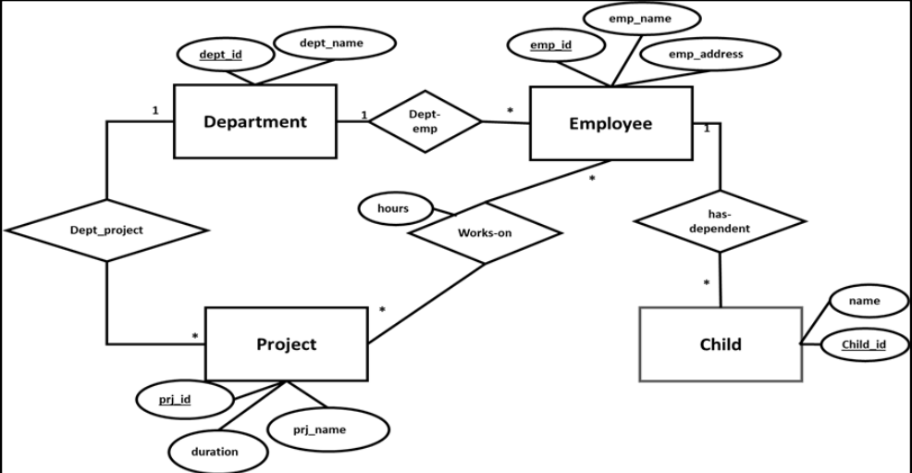
A. Relational Database
A standard benchmark database named Employee is used. The entity-relationship diagram (ERD) is shown below.

Slide 7
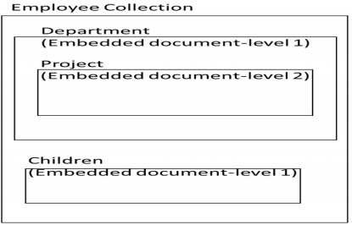

B. MongoDB Structure
In converting a relation database into NoSQL model, MongoDB has two ways of modelling relationships between relations/entities, namely, embedding and referencing. In this paper, Employee database has been transformed into three MongoDB-based NoSQL structures. The first structure is based on embedding all the data about employees in one collection called Employee Collection.

Slide 8
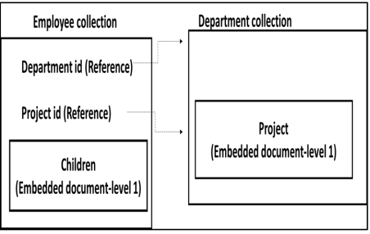
B. MongoDB Structure
The second NoSQL structure divides the data into two collections. The first collection is the Department collection and it contains information about departments and their projects. Project information is represented as an embedded collection in the department collection. The second collection is the employee collection contains information about employees, their departments and projects information using references, and the children information as an embedded document

Slide 9
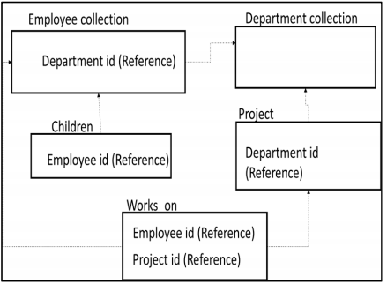
B. MongoDB Structure
The last NoSQL structure represents each relational table into separate collection. All relationships are implemented using references.

Slide 10
C. Query Description
To compute the performance of each NoSQL structure, benchmark retrieval queries are developed. In this benchmark queries, we considered different complexity levels of retrieval including indexing, joining tables, and aggregations.

Slide 11
Experiments
A. Setup
MySQL server version 5.7.17 MySQL Community Server (GPL) for relational database and MongoDB version v3.4.1. Both databases are running on MacBook Pro (13-inch, Mid 2010) with 2.4 GHz Intel Core 2 Duo processor, 4 GB 1067 MHz DDR3. We use Java to develop the API for managing the communication with the DBs through NetBeans IDE 8.2. The library used to access MySQL server DB for java API is “mysql-connector-java-5.1.40-bin.jar”, and the other one used to access MongoDB is “mongo-java-driver-3.4.1.jar”.

Slide 12
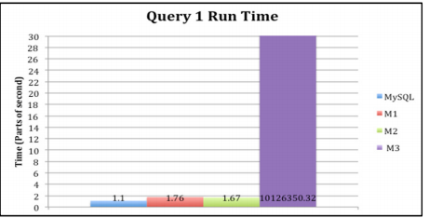
B. Results and Analysis
Query 1. MySQL database achieved better retrieval time compared with all MongoDB structures. Query 1 retrieves all the information about one employee. Retrieval times of MongoDB structure 1 (M1) and structure 2 (M2) are very close while structure 3 (M3) took 28 hours because MongoDB structure 3 uses references to lookup data.

Slide 13
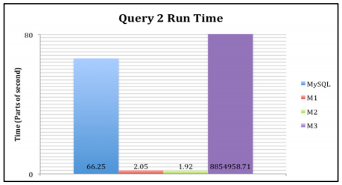
Query 2. MongoDB structure 2 (M2) outperformed other structures and MySQL with 1.92 milliseconds. The retrieval time of MongoDB structure 1 (M1) execution time was very close to MongoDB structure 2 (M2) execution time. We observe that a noticeable increase in the execution time of the same query in MySQL structure, as the query will access projects and works_on tables to find employee id then it will get all the information related to that employee. All of the three previous structures execution time was very short compared with the execution time of MongoDB structure 3 (M3) which reached about 24 hours to get the results. The reason behind the very high execution time in structures 3 (M3) is the reference relationship between the collections and the need to access all the collections after finding the employeeID required

Slide 14
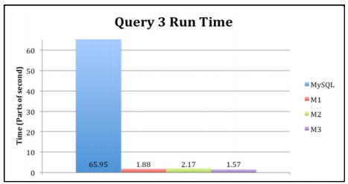
Query 3. For Query 3, MySQL database structure recorded the longest time. The time needed to retrieve data was about 65.95 milliseconds because in MySQL the process will join two tables namely, Works_on table and Project table on an non-key fields. In MongoDB structures M1, M2, and M3, results were close to each other. We can conclude that any representation in MongoDB is better than MySQL representation of data in executing this kind of queries that does not rely on key data.

Slide 15
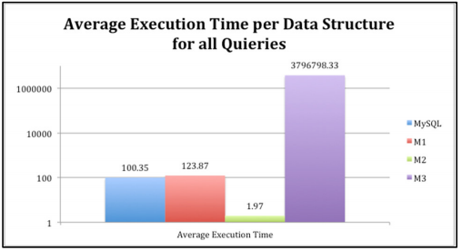
Like the above queries, 2 more queries were tested. And the average time of all queries is shown below
Overall, results show that using embedded structures along with references would make retrieval times reasonable and can easily outperform relational databases. Additionally, designing NoSQL with only references or embedded documents makes searching/retrieval worse than relational databases

Slide 16
Conclusion
In this paper, we investigated different NoSQL structures to represent relational databases. MongoDB for NoSQL and MySQL database as a relational database. The experiments are based on three NoSQL structures that include embedding documents only, referencing documents only, and both.
We used large number of records and a set of five queries as a benchmark to measure retrieval time. Our benchmark database contains five tables and variety of relationships that include many-to-one, and many-to-many.
The final finding of this research indicates that using both embedding and referencing of documents

Slide 17
References
https://ieeexplore.ieee.org/document/8606019
https://www.mongodb.com/nosql-explained/nosql-vs-sql
https://blog.timescale.com/blog/why-sql-beating-nosql-what-this-means-for-future-of-data-time-series-database-348b777b847a/

